Slide 1

A resource by:
Primary school morning challenges, story starters and maths warmups, for every single day of the year!

Slide 2





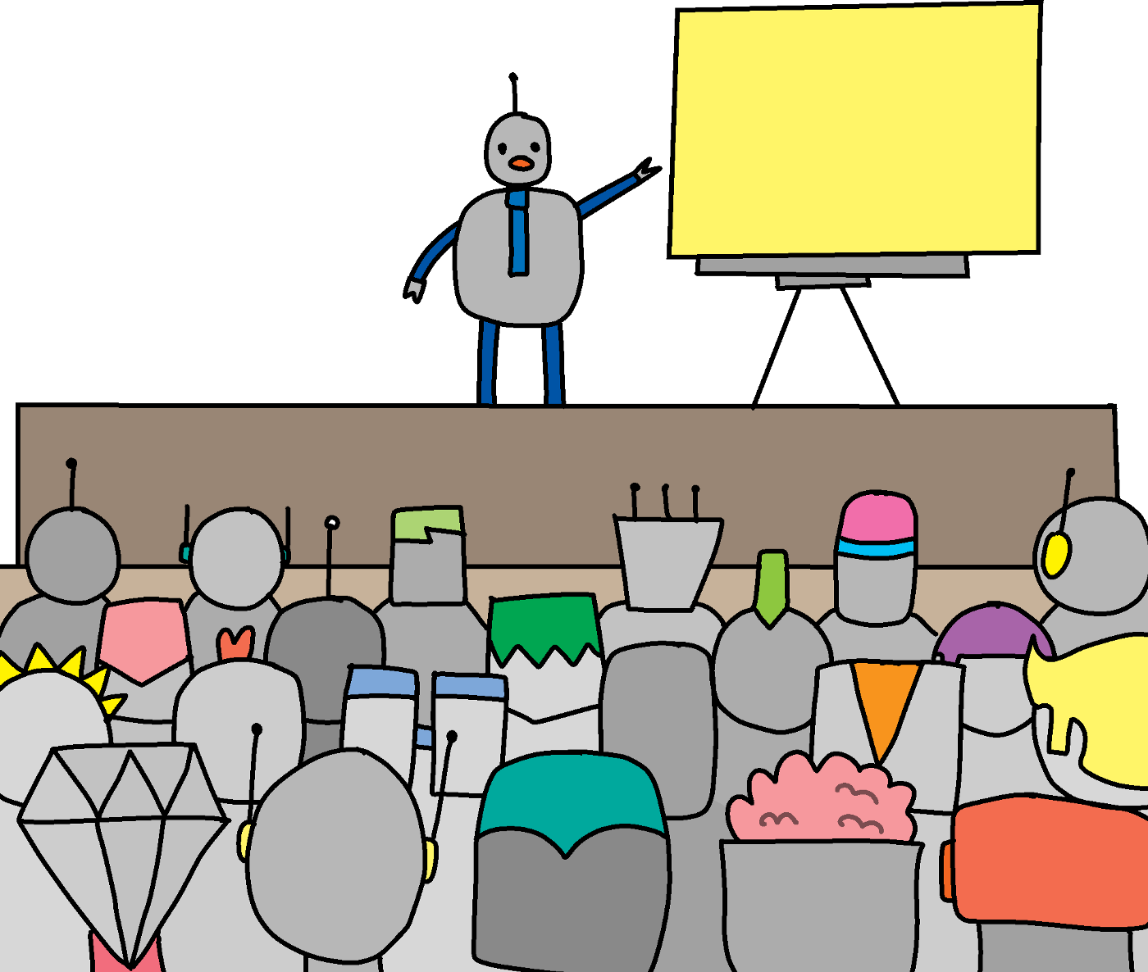


Morning Challenge
Maths
English
Science
Assembly
Reading
Reward
Social Studies

Slide 3




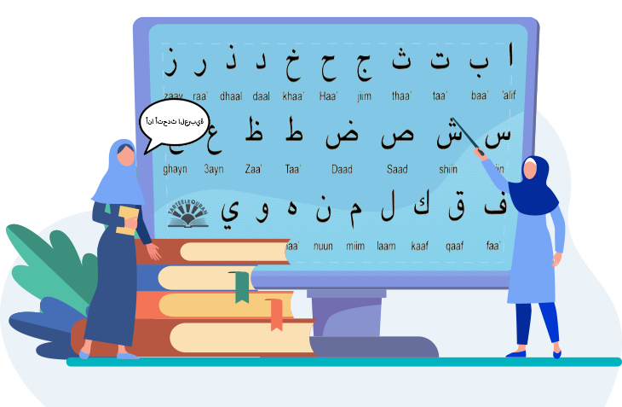



Spelling
Islamic
French
Spanish
PSHE
Arabic
German
Mandarin

Slide 4






Geography
Topic
Humanities
Art
History
Computing
P.E
Guided Reading

Slide 5








Lunch
Trip
Design & technology
Music
Break
Visitor
Handwriting
Home Time

Slide 6

R.E
Edit Me!
Edit Me!
Edit Me!
Add a selection of other subjects, or things, that you cover!

